Slide 1

Patient Management System
Team Blue
Lars Gertsch | Simon Herrmann | Steve Blaser | Fabio Caggiano | Silas Stulz | Sinthujah Kaneshan

Slide 2
Contents
- Features implemented vs. Design thinking ideas
- Architecture & coding highlights
-
- Lessons learnt / Scrum retrospective

Slide 3

Features implemented vs. Design thinking ideas

Slide 4
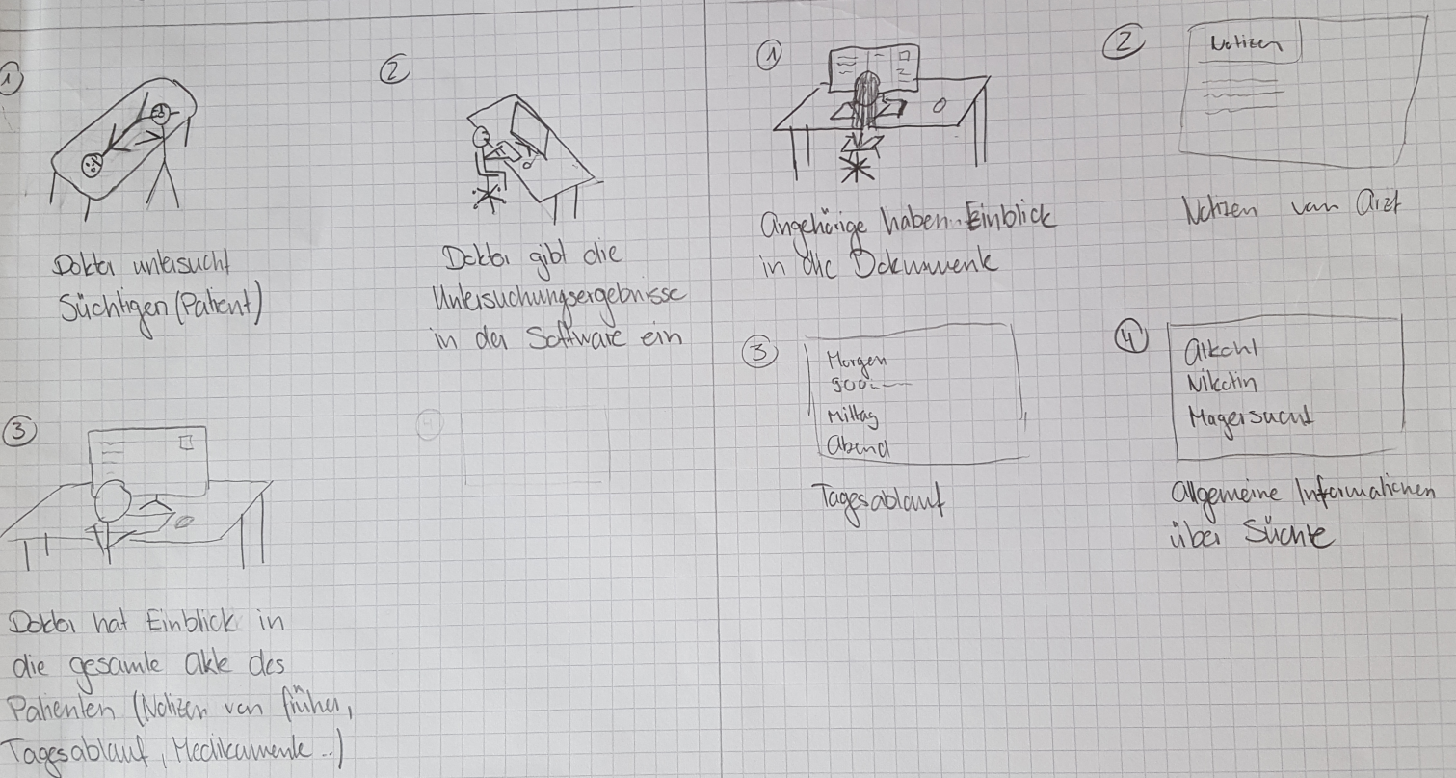

Slide 6
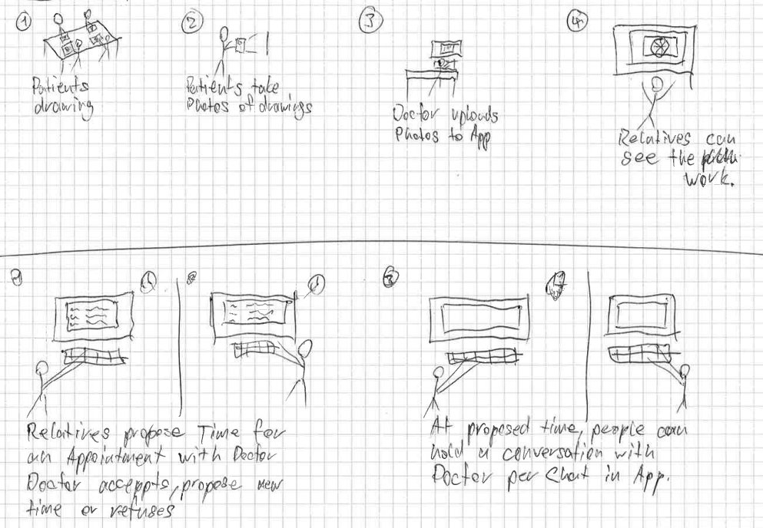
Team Blue
6

Slide 8
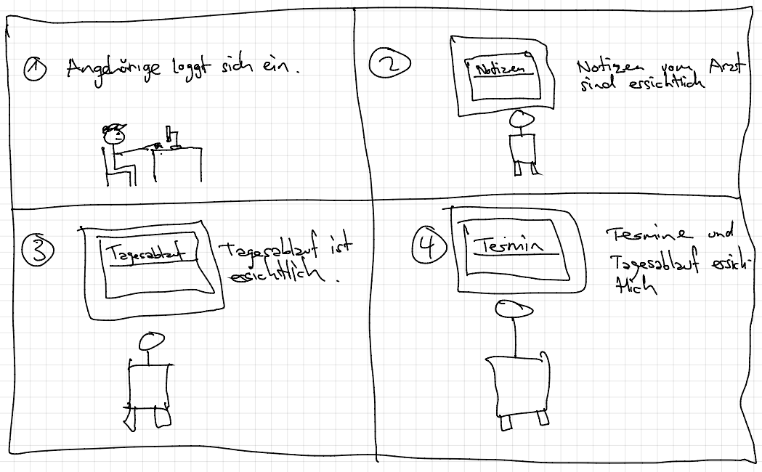

Slide 10
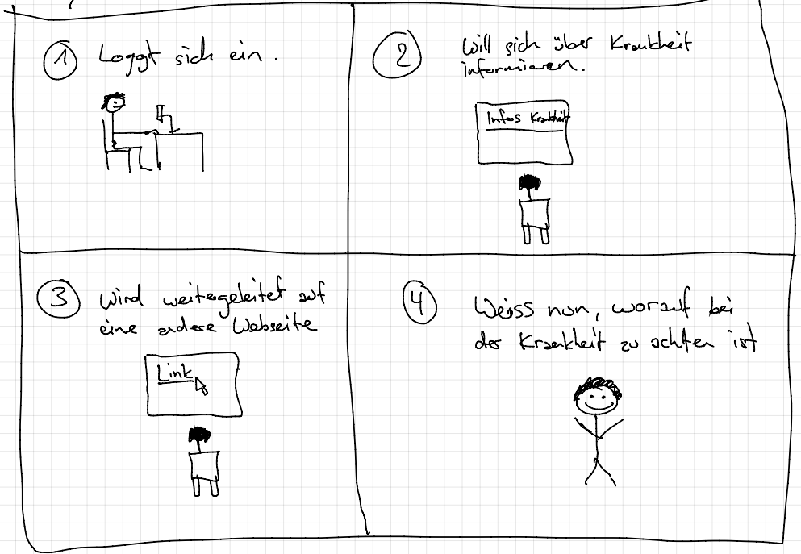

Slide 12
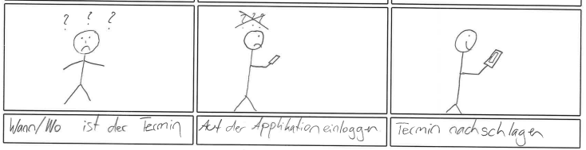

Slide 14
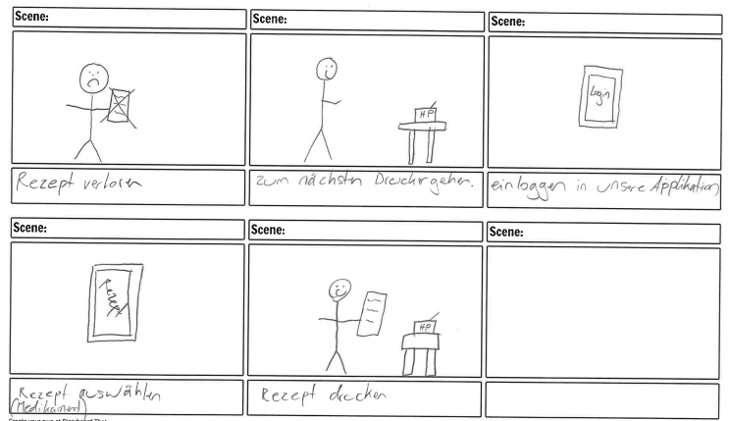

Slide 16
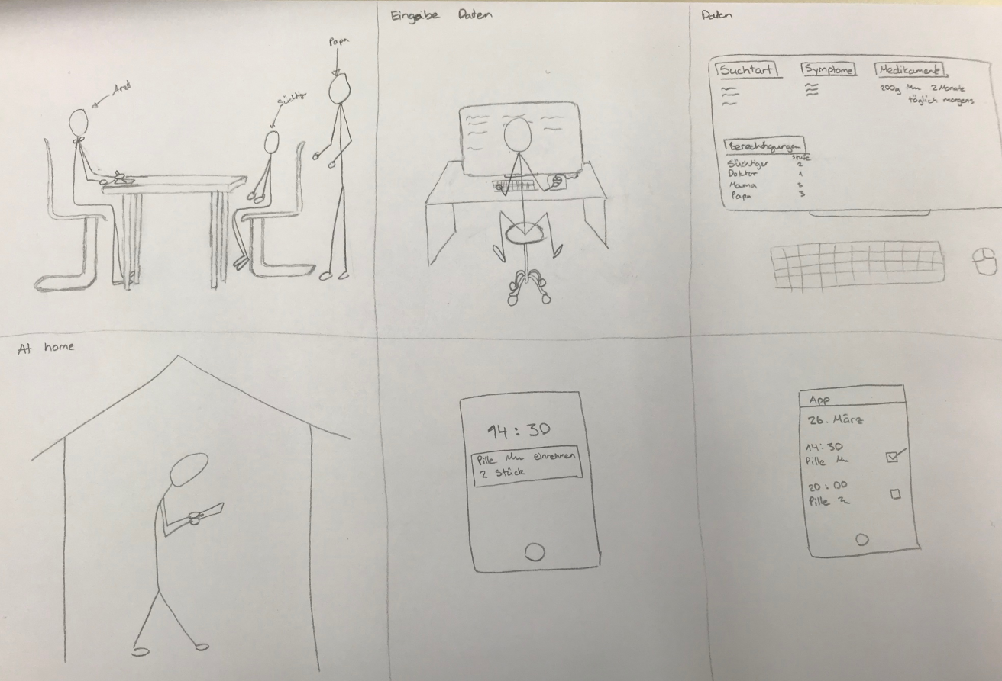

Slide 18
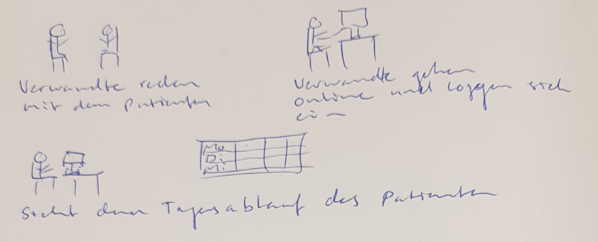
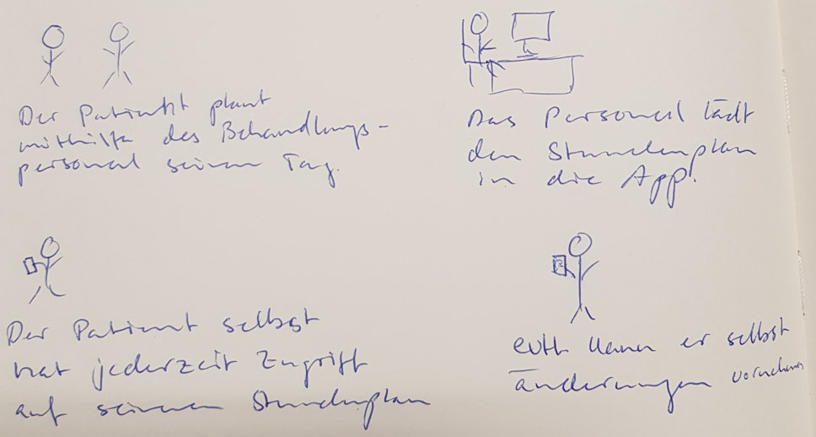

Slide 20
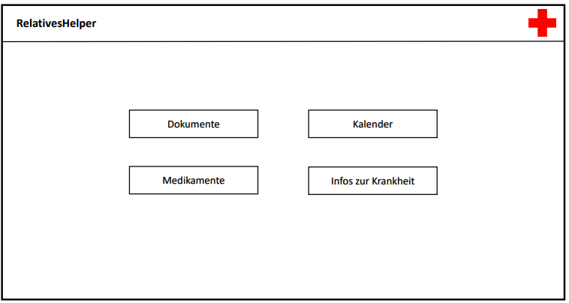
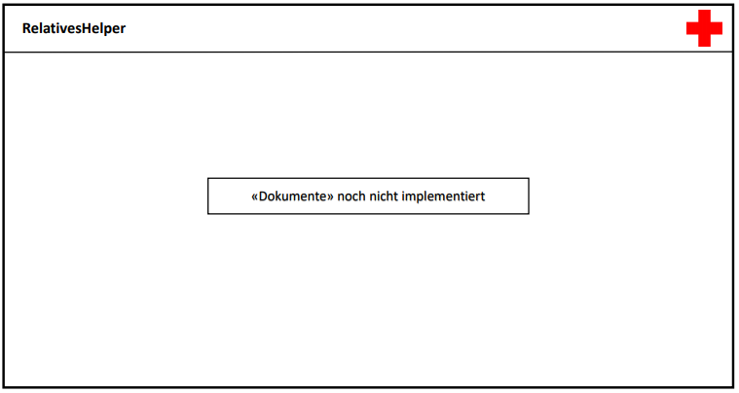

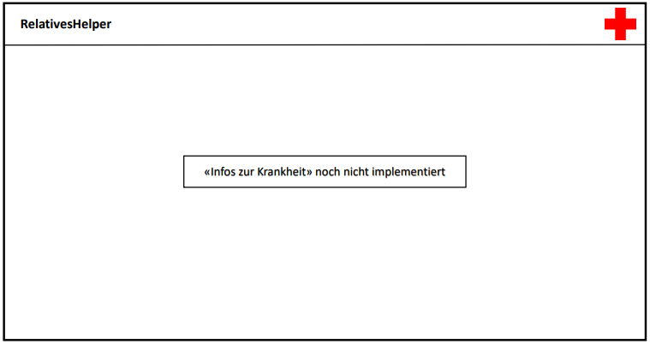
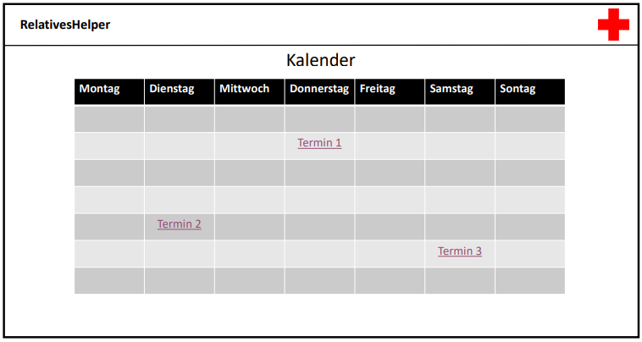
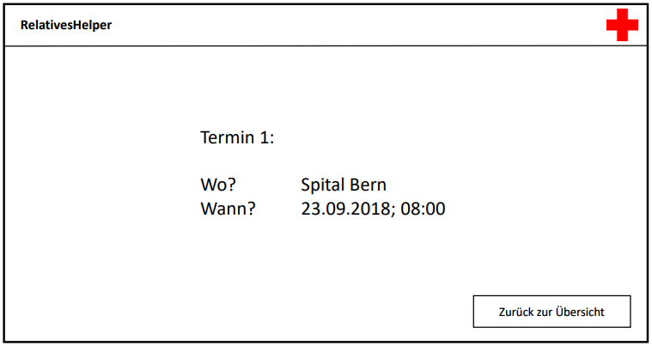

Slide 22
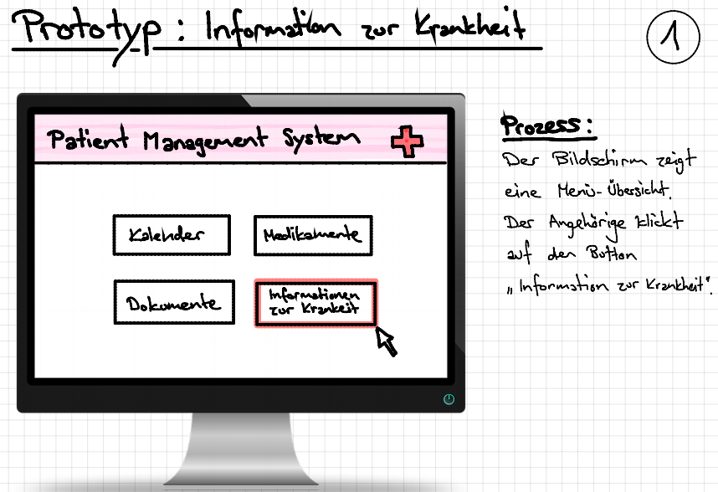
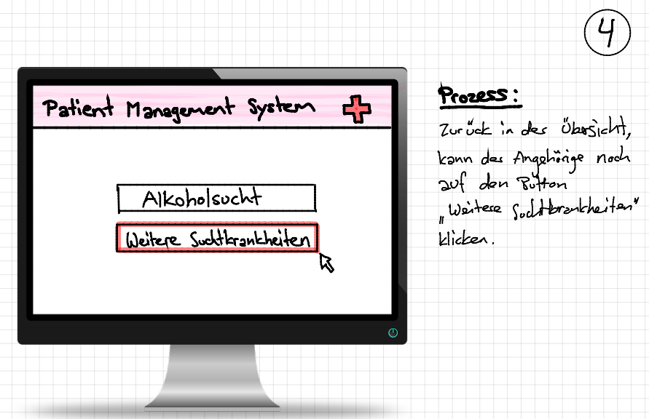
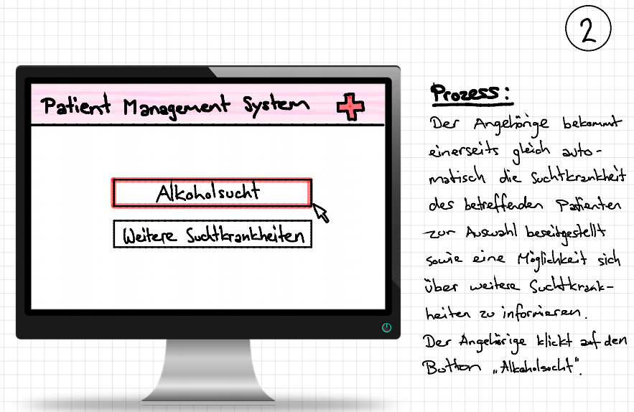
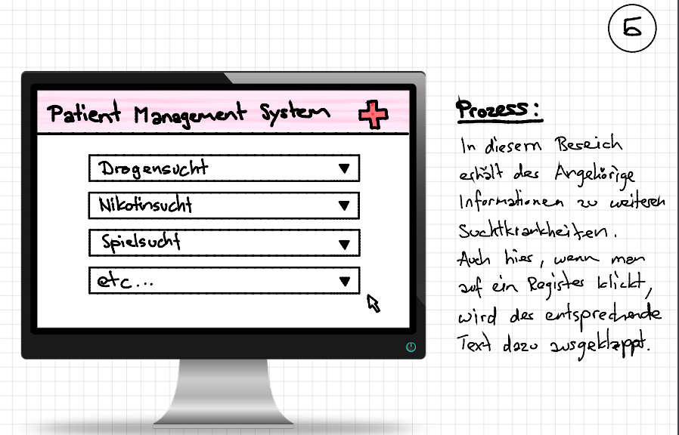
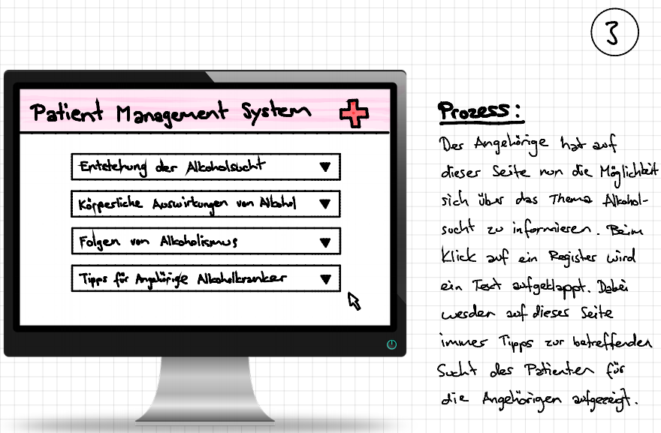

Slide 24
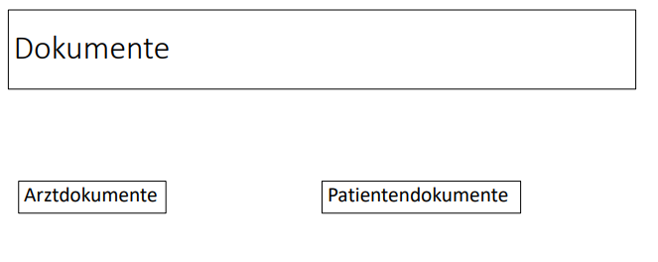
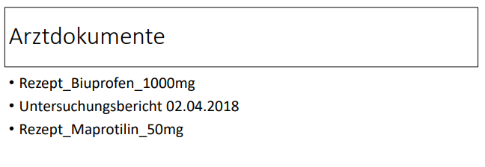

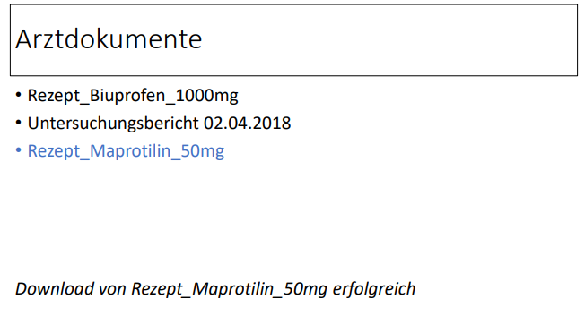

Slide 26

Architecture & coding highlights

Slide 27
MVP Pattern
Architecture of Calendar:
Model
Task
File
View
Interface CalendarView
CalendarViewImpl
Presenter
CalendarPresenter

Slide 28
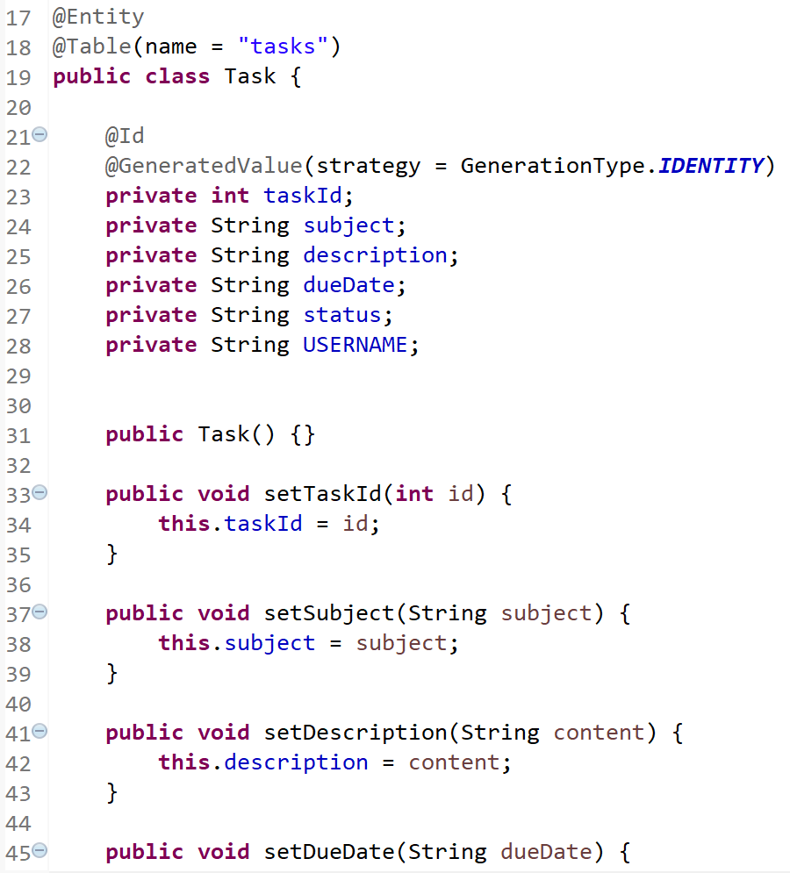
Task

Slide 29
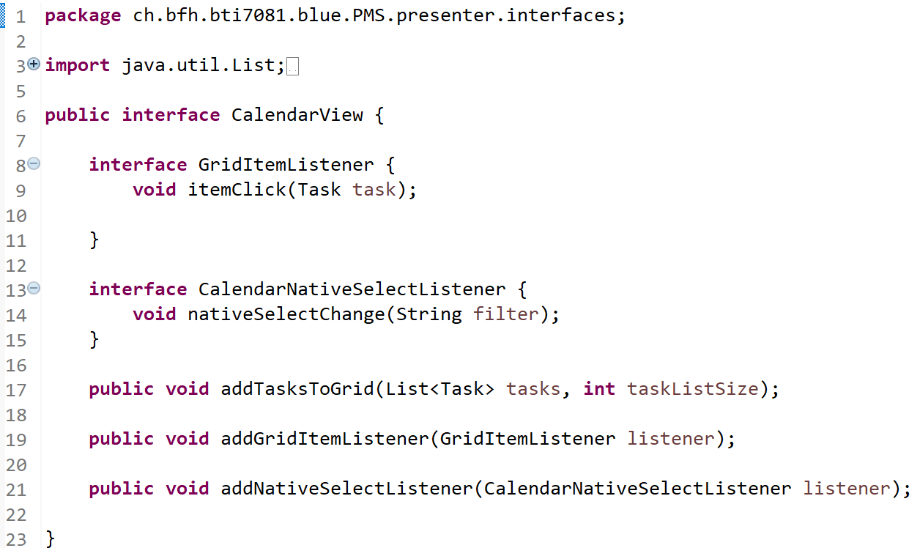
Calendarview

Slide 30
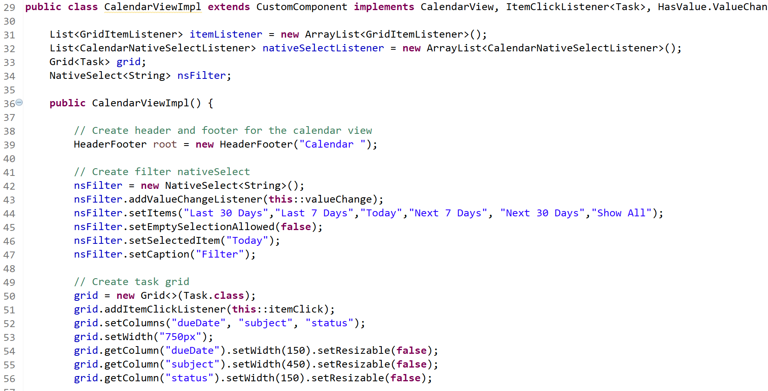
Calendarviewimpl: Gridsetup

Slide 31
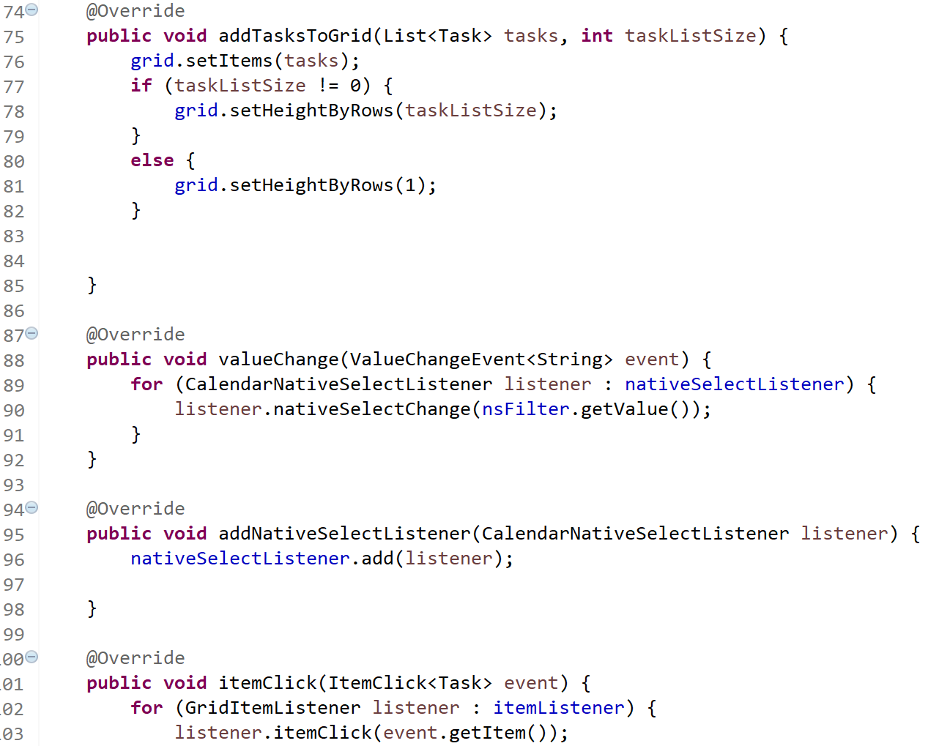
CALENdarviewimpl: Listeners

Slide 32
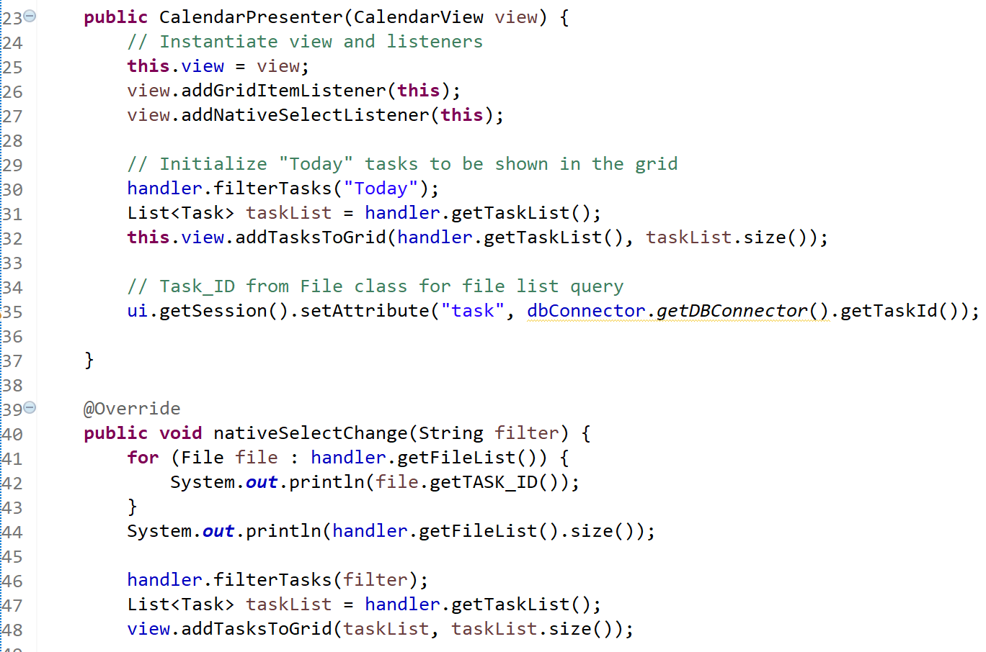
CALENdarpresenter

Slide 33
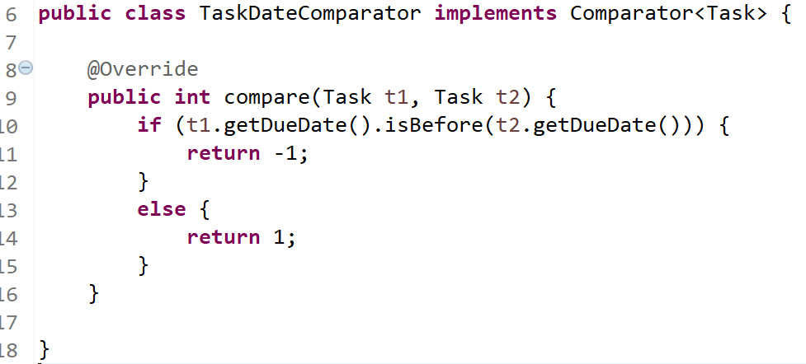
TASKDatecomparator

Slide 34
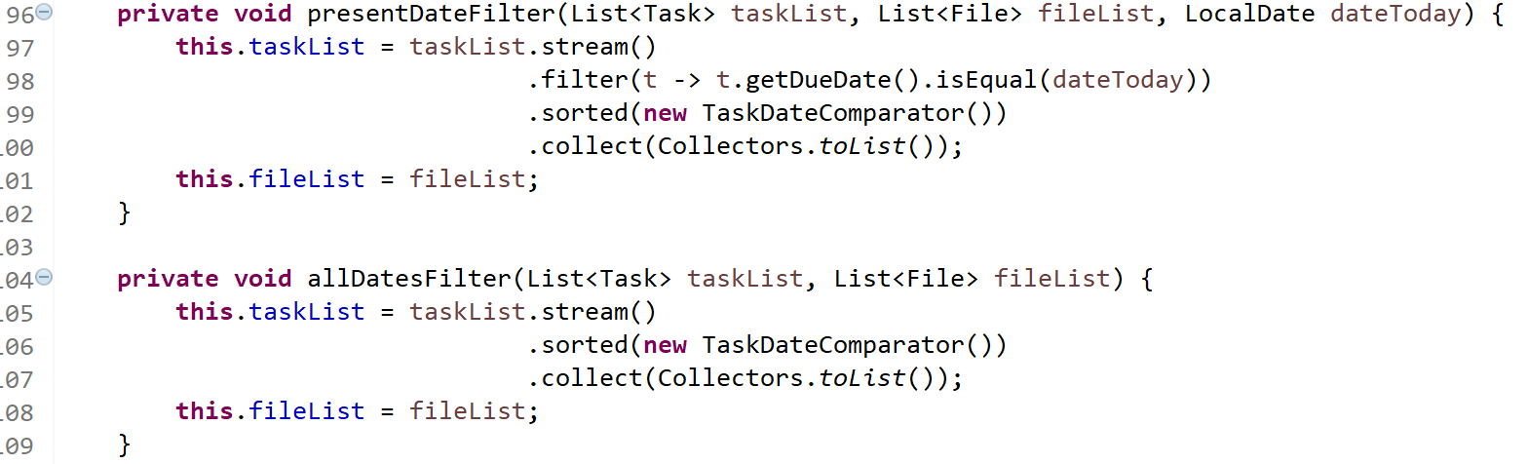
TASKDBHandler

Slide 36

Personal Contribution

Slide 37
Startsite

Slide 38
Kalendar

Slide 39
Information

Slide 40
Chat

Slide 41
Information

Slide 42

Lessons learnt / Scrum Retrospective

Slide 43
Lessons learnt

Slide 44
Retrospective

Slide 45


